Slide 1
STAC: The SRAM Timing Analysis Chip
Rahul Kumar, Rohan Kumar

Slide 2

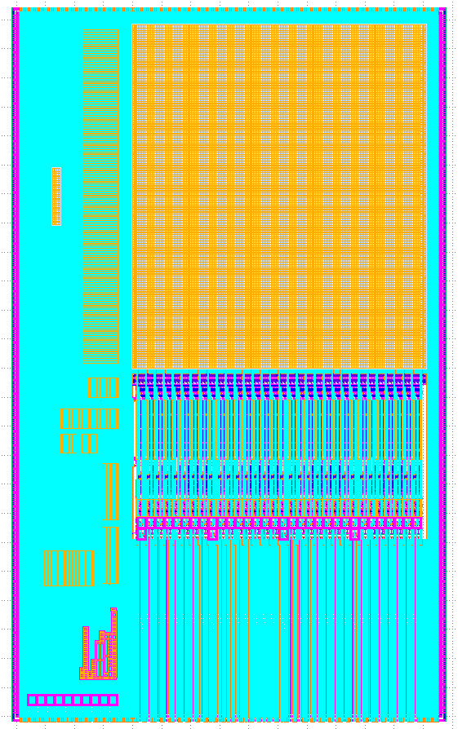
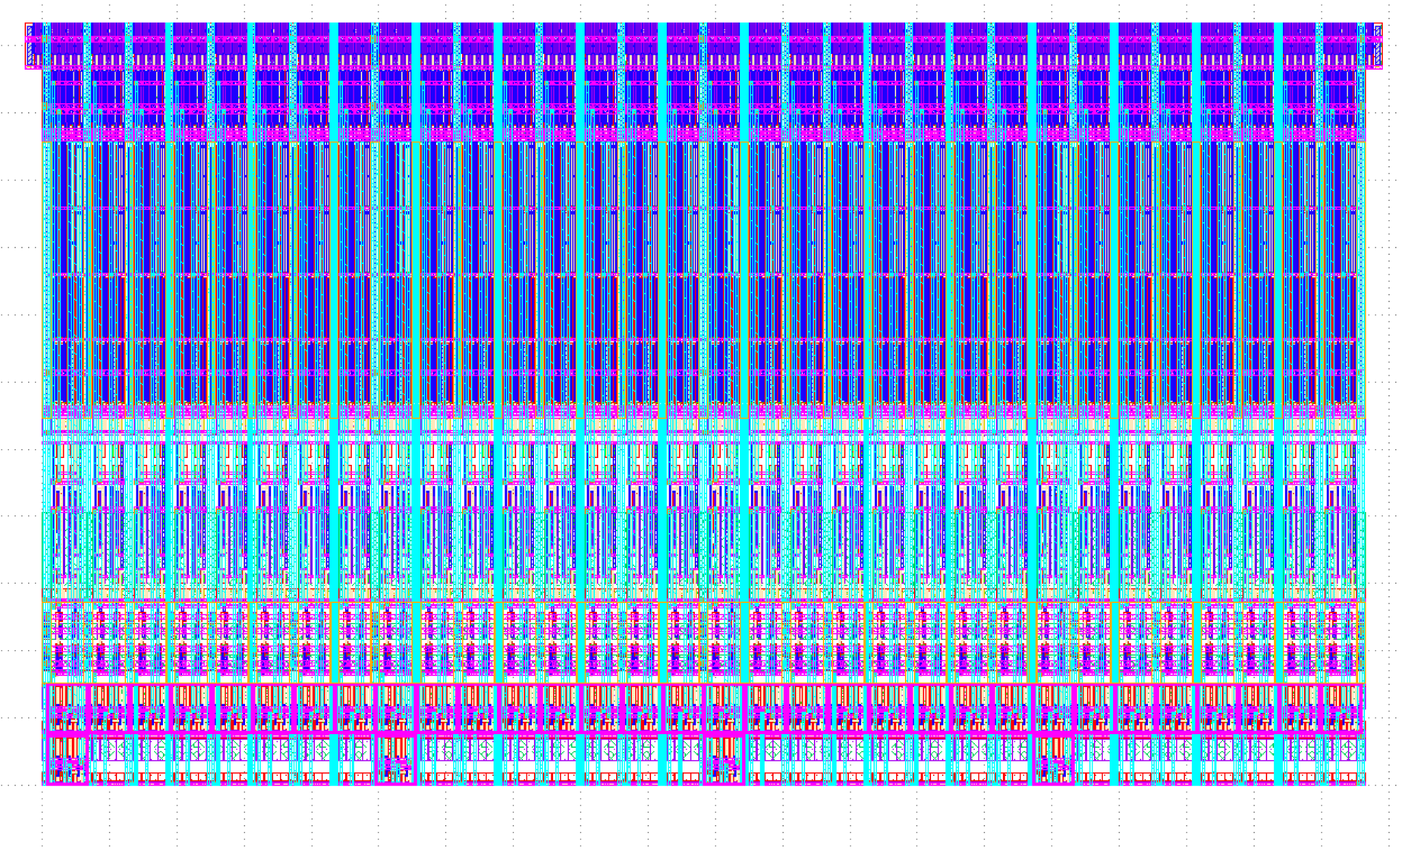
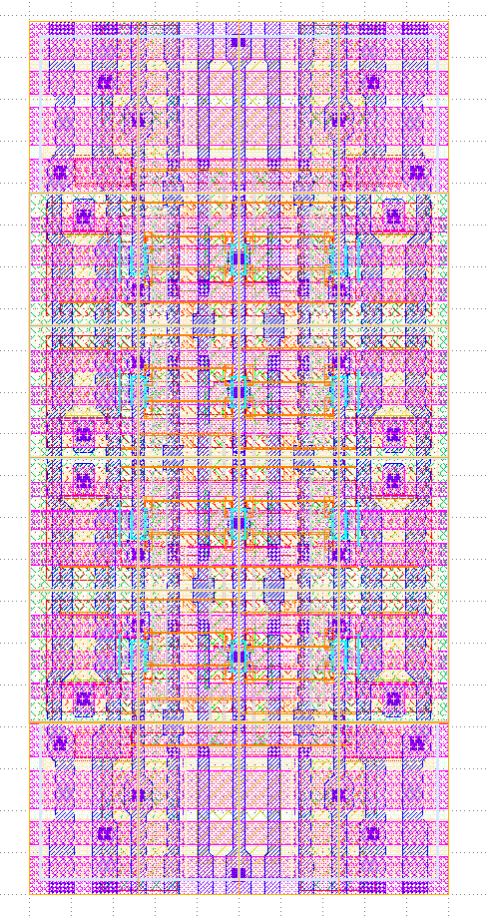
SRAMs
Static random access memories
Compact volatile memory
Fairly regular layout -> well-suited to generators
Useful for various applications

Slide 3
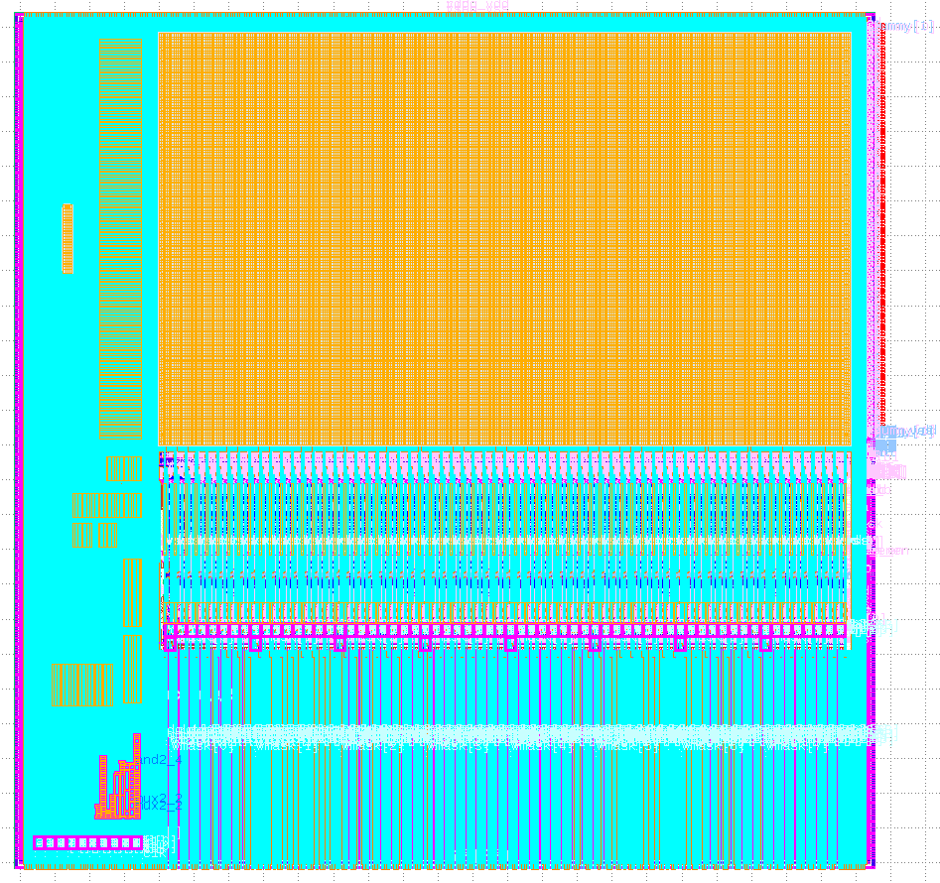
SRAM22
Open source, built using an AMS generator framework written in the Rust programming language (Substrate)
Used to generate SRAMs in SKY 130 for tapeout in June

Slide 4
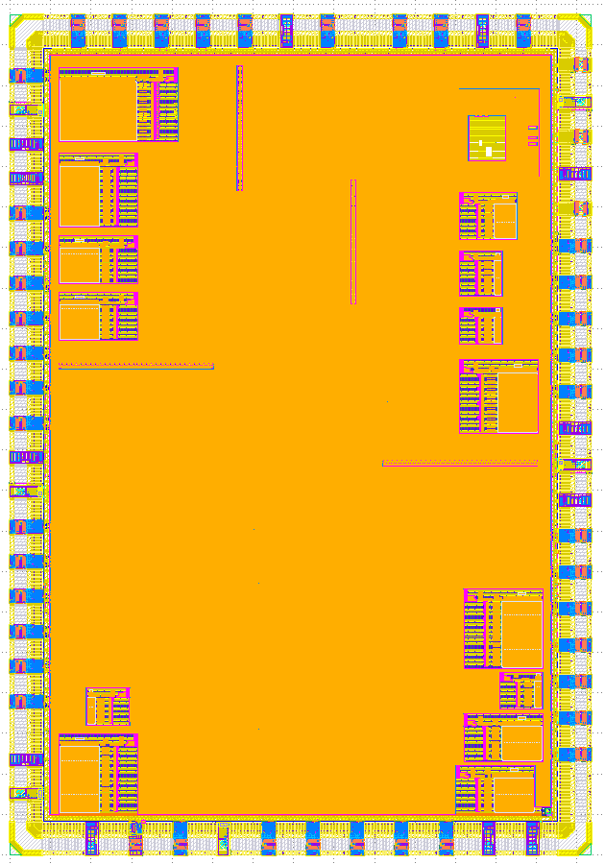
STAC: SRAM Timing Analysis Chip
What’s on the chip?
64-bit Rocket core
4 kB scratchpad SRAM
5 icache/dcache SRAMs
8 “test SRAMS” with extra instrumentation
2 delay lines + 2 TDCs
Digital BIST
Scan chains for bypassing core

Slide 5
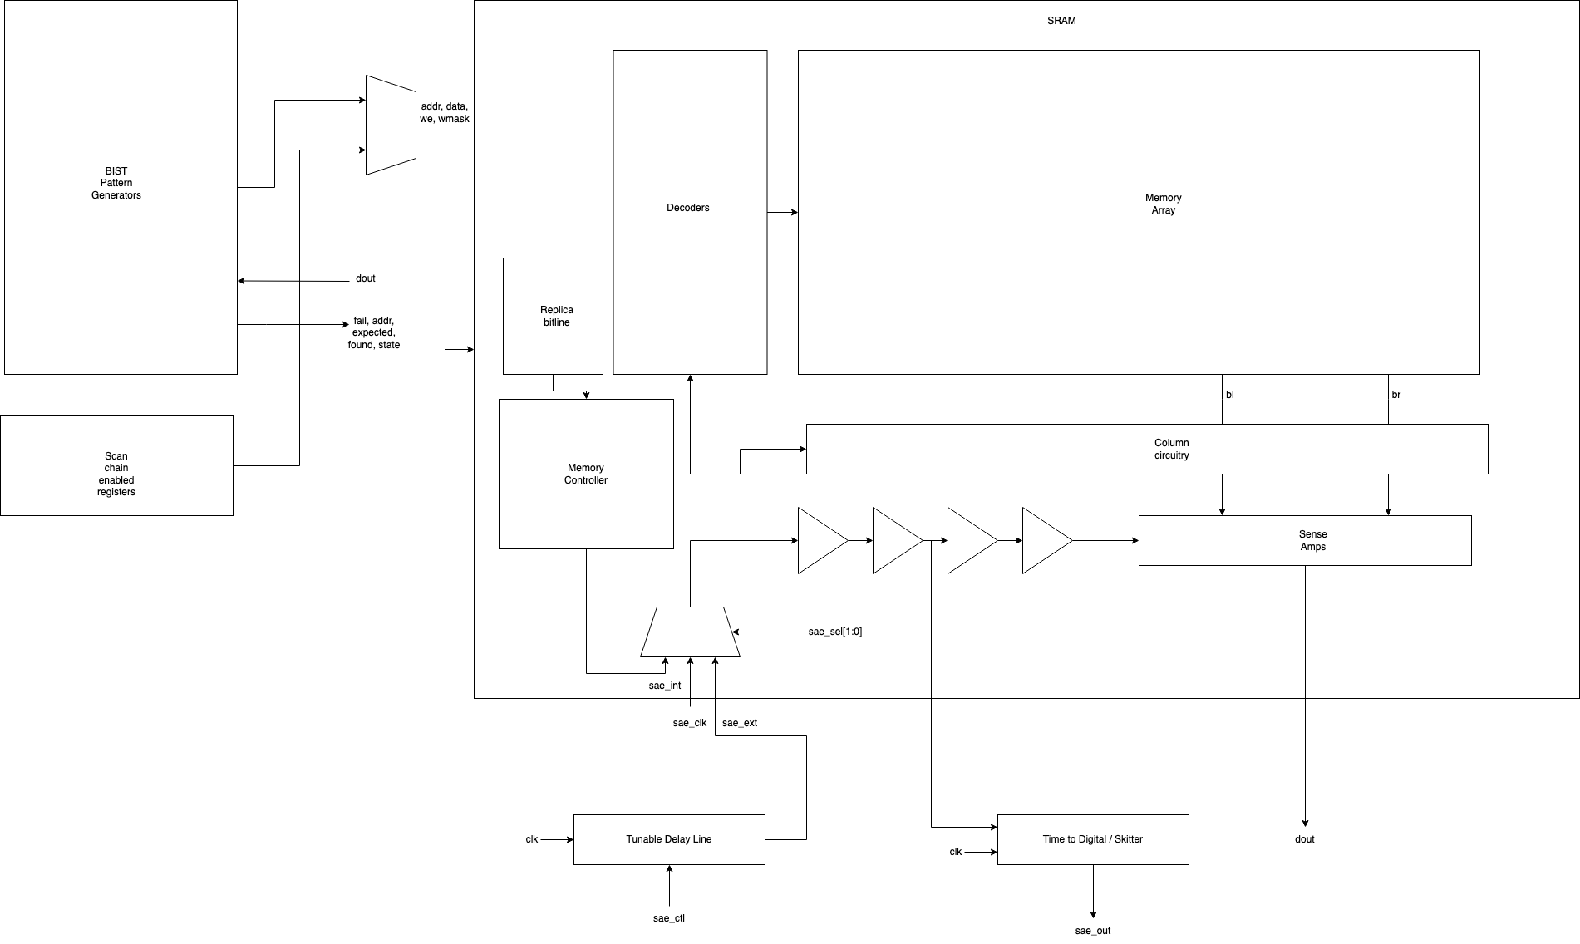
SRAM Timing Analysis
Can clock SRAM sense amplifiers with an externally provided clock, or via a delay line
Measure the minimum delay needed for correct readout
Compare internal replica circuitry to minimum delay

Slide 6
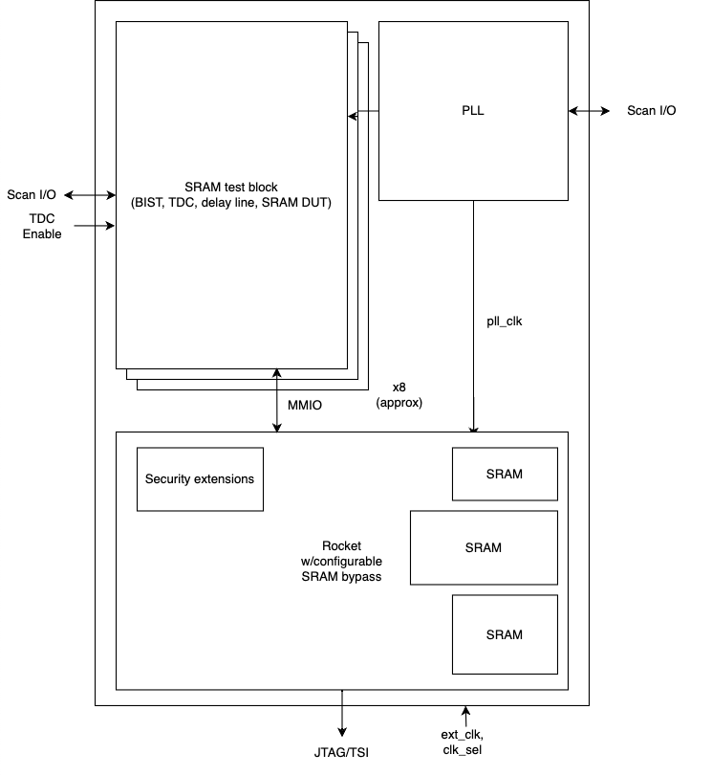
SRAM Test Infrastructure
Redundant:
MMIO via JTAG/UART
Serial TL
Fiddling with GPIO pins (scan chain)
Built-in Self Test (BIST) for at-speed testing of test SRAMs
Manual write option for patterns that cannot be tested by the BIST
Custom boot ROM for bringup via UART (Allison Husain)

Slide 7


How STAC was made
The first digital top in Skywater 130nm
Infrastructure for interfacing IO cells with Innovus (Ethan Wu)
Digital RTL: generated by Chipyard/Chisel
VLSI flow: Hammer
SRAMs: SRAM22 + Substrate
Digital debug interfaces worked on nearly the first try!

Slide 8
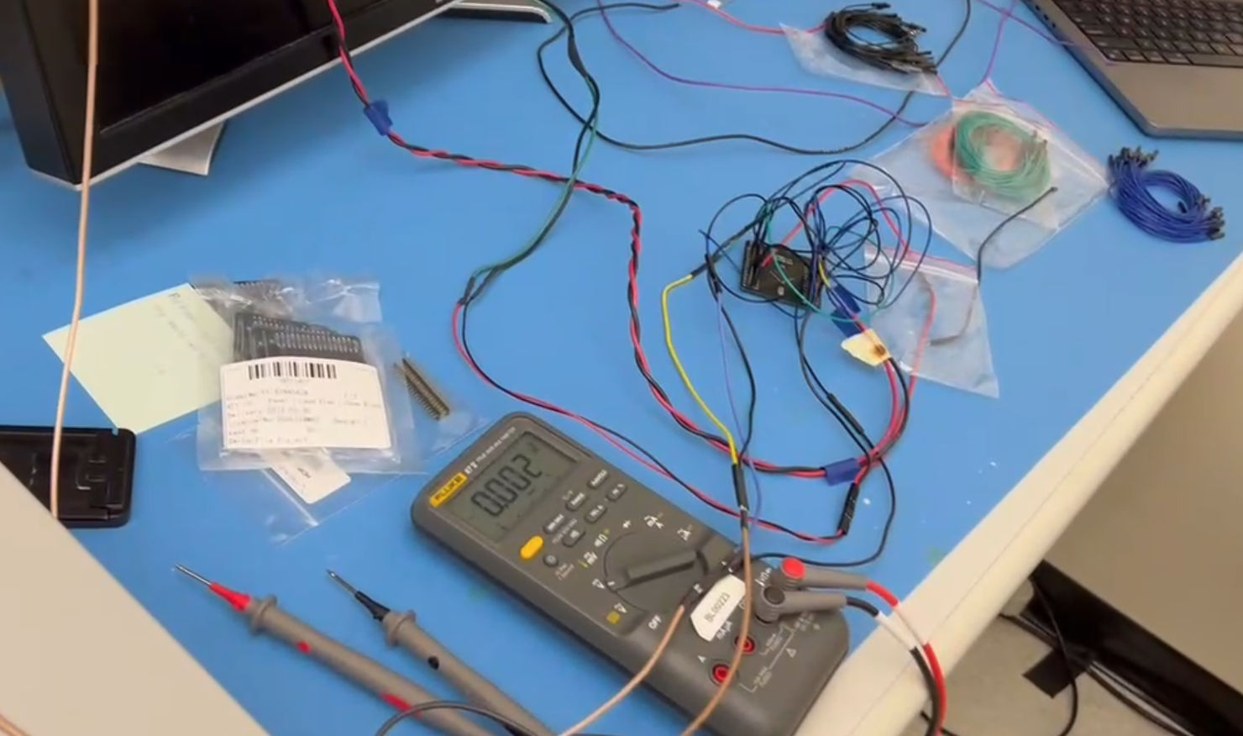
STAC Bringup
JTAG/scan chain interfaces seem to work correctly in preliminary tests with breakout board
Briefly tested scratchpad (512x64 SRAM generated by SRAM22) via MMIO
Need a new board for more rigorous testing

Slide 9
STAC Bringup (cont.)
Unable to read/write test SRAMs yet
May be due to current bringup setup or timing issues in the testing instrumentation
Waiting for better boards to debug

Slide 10
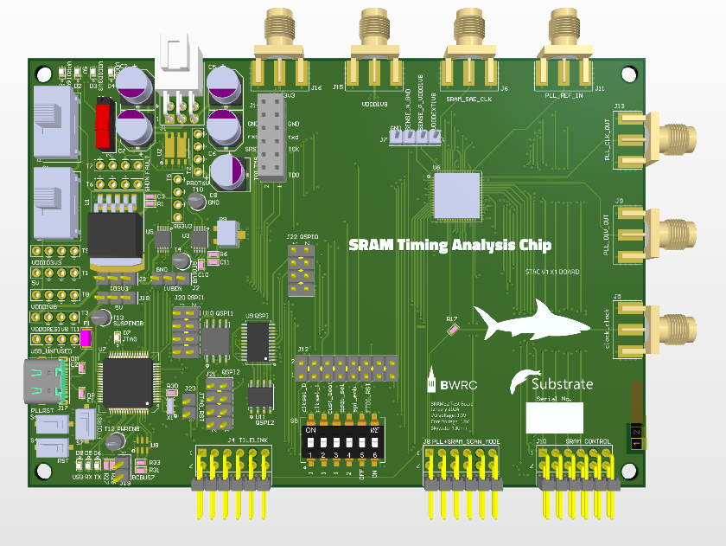
STAC Board
Better board coming soon!
Power regulation and protection
USB-C to JTAG/UART for standalone debugging
Plugs in to ARTY FPGA board for testing

Slide 11
Future work
Debug timing issues in test SRAM clock path
Thoroughly characterize scratchpad SRAM
Update SRAM22 and tape out updated version of STAC (hopefully in April)

Slide 12
Conclusion
Digital top will enable us to consistently tape out (somewhat) working SKY 130 chips
The standard SRAM macros generated by SRAM22 seem to be mostly working, though further testing needs to be done
All code used in the tapeout is open source:
SRAM22: https://github.com/rahulk29/sram22
Substrate: https://github.com/ucb-substrate/substrate2
Tapeout top: https://github.com/ucb-bar/stac-top

